Slide 1
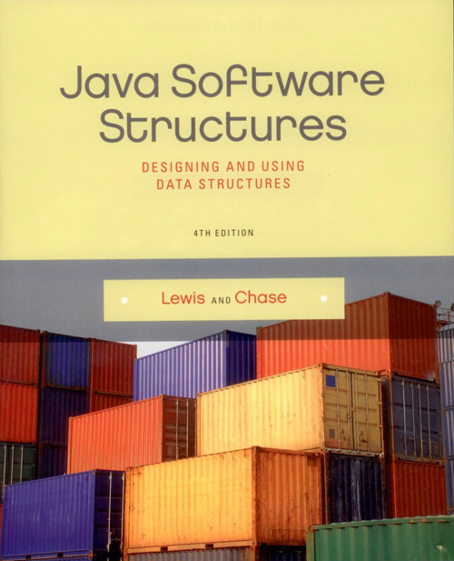
Chapter 1
Introduction

Slide 2
Chapter Scope
Aspects of software quality
Introduction to data structures

Slide 3
Software Development
Software Engineering is the study of the techniques and theory that support the development of high-quality software
The focus is on controlling the development process to achieve consistently good results
We want to:
satisfy the client – the person or organization who sponsors the development
meet the needs of the user – the people using the software for its intended purpose

Slide 4
Goals of Software Engineering
Solve the right problem
more difficult than it might seem
client interaction is key
Deliver a solution on time and under budget
there are always trade-offs
Deliver a high-quality solution
beauty is in the eye of the beholder
we must consider the needs of various stakeholders
Accomplish it all in an ethical manner

Slide 5
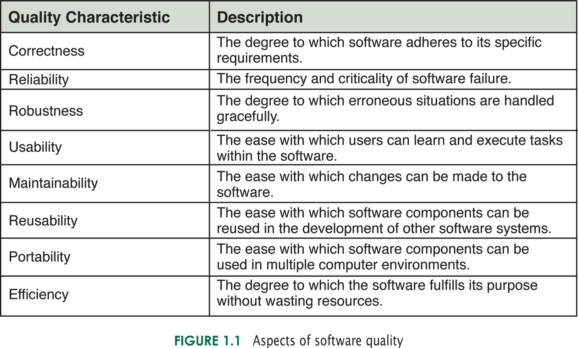
Aspects of Software Quality

Slide 6
Data Structures
The data structures examined in this book lay the foundation for developing complex software
Software Engineering techniques are needed as our software grows more complex
As we discuss data structures, we will also practice good software engineering

Slide 7
Data Structures
A physical example of objects to manage: shipping containers at a dock
They must be managed carefully and efficiently
None can be lost
The containers are generic (same shape and size) but contain different cargo
Each has an identification number
The handlers don't need to know what's inside the containers

Slide 8
Data Structures
Many issues come up
How many might we need to hold at any point?
How do we keep them organized?
One big line?
Sorted by id?
A grid?
Does the order in which they will be unloaded or loaded onto ships matter?

Slide 9
Data Structures
It turns out no one solution will address all issues adequately
Sometimes we'll need to stack them (to reverse the order)
Sometimes we'll want to take them in the order they arrive
Sometimes more complex solutions are required

Slide 10
Data Structures
This book explores many options for managing the objects we use in our software
Quality issues as well as flexibility will be important factors

